Slide 1
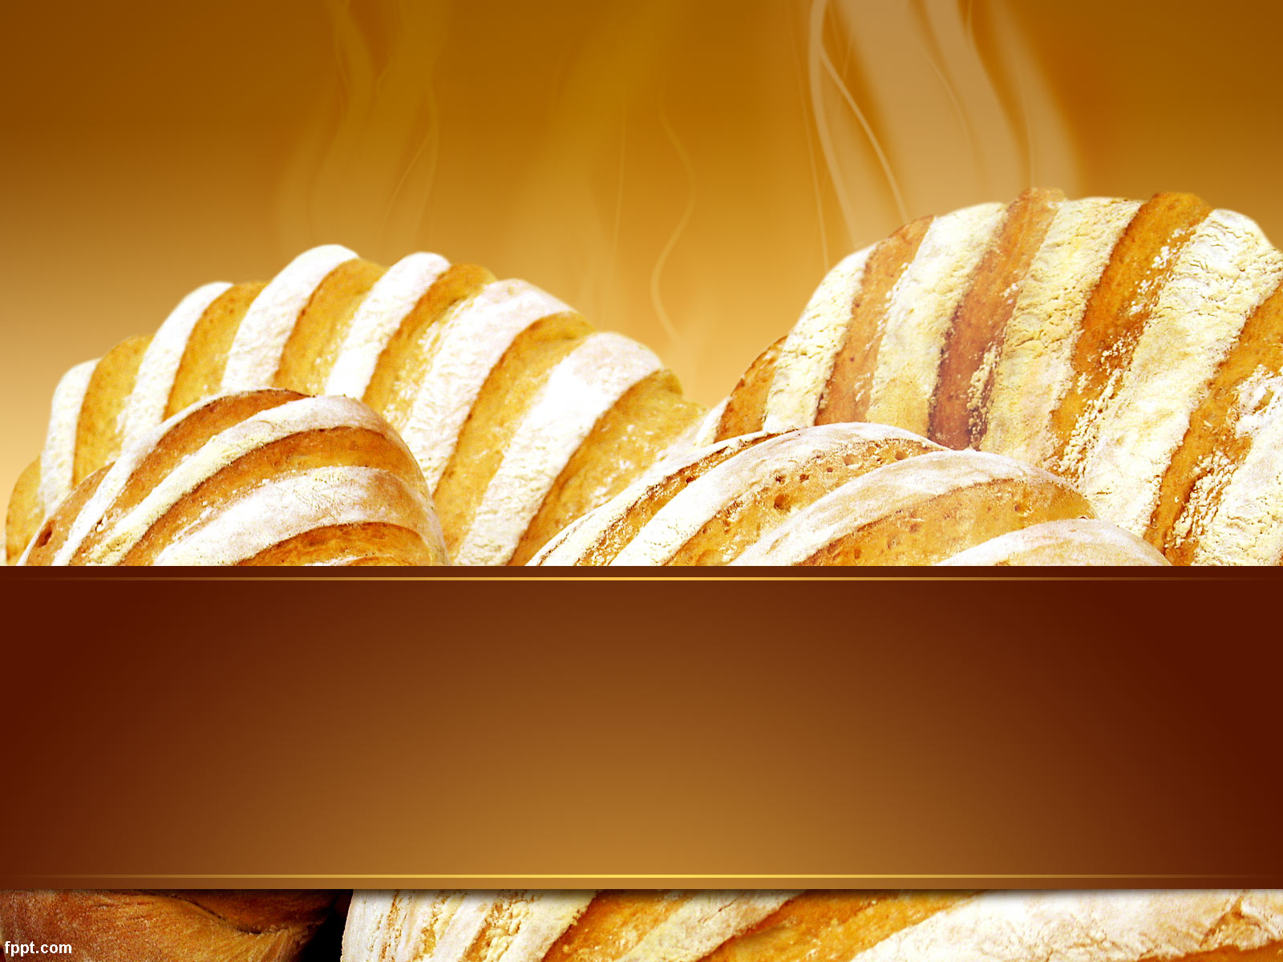
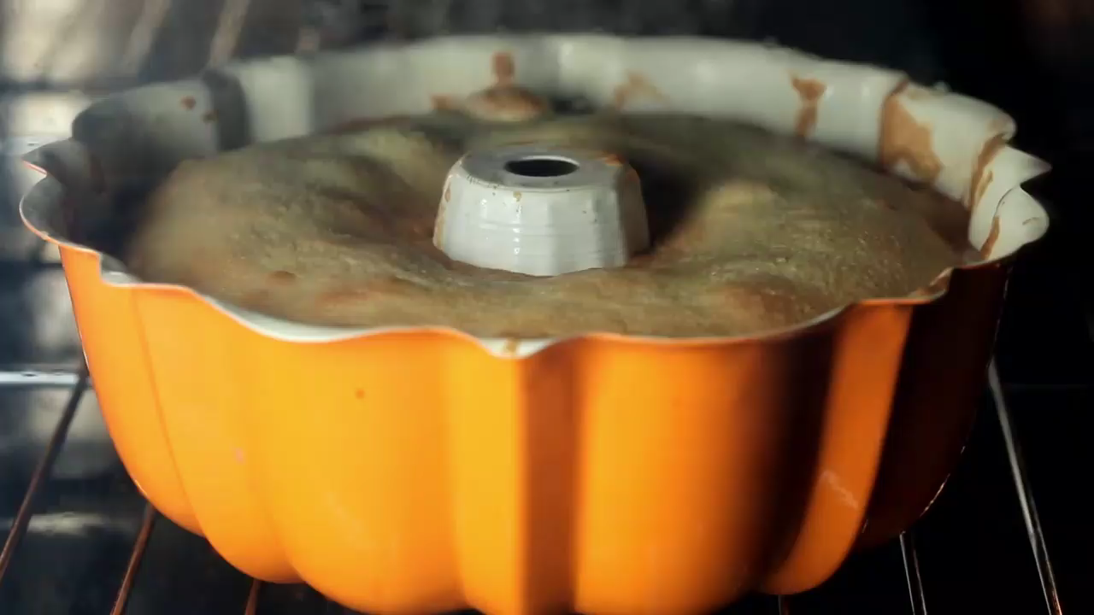
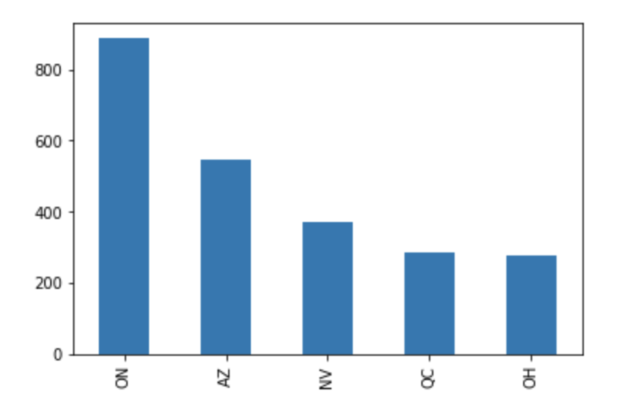
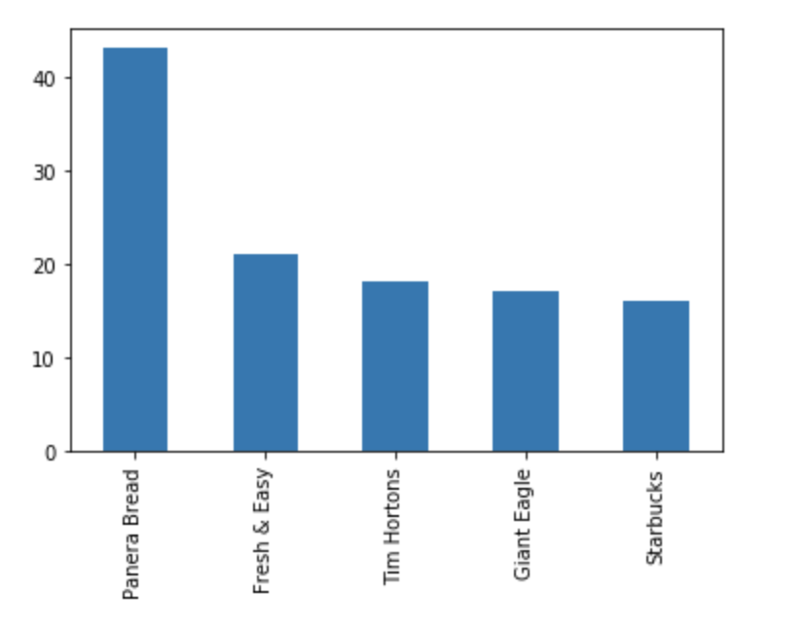
DATASET
Amount: 2815
Total review:20480
Check-ins: 15816233
Yelp Analysis
Bakery
Jordan Fisher , Jeeva Ramamoorthy
Qiao Zhang, Wanmo Chen, Xuan Yang

Slide 2
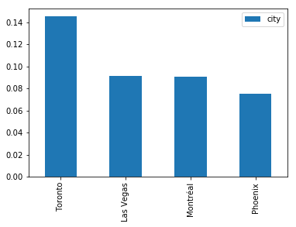
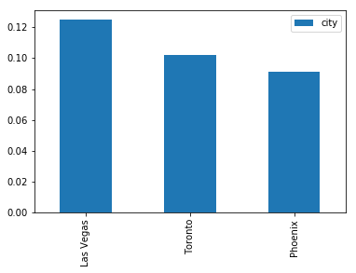




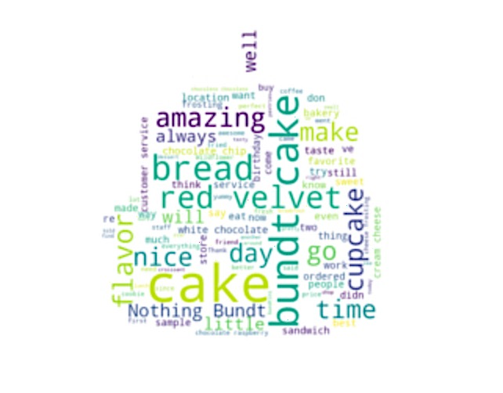
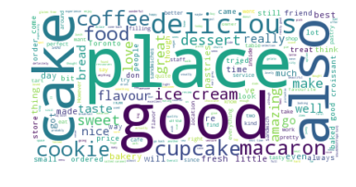
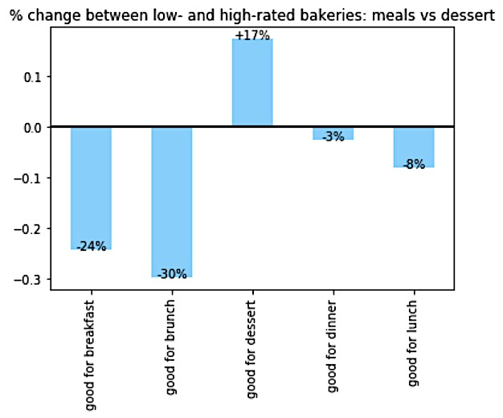
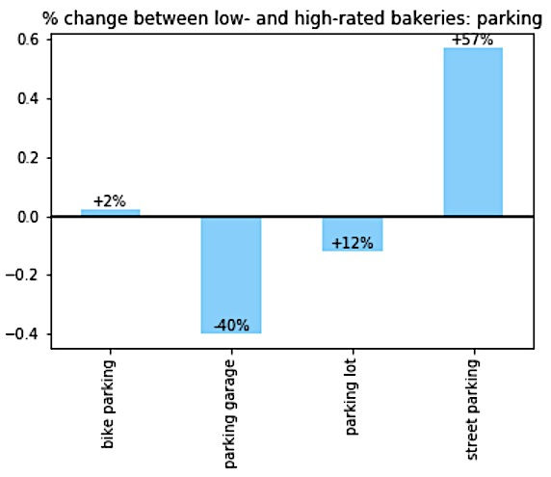
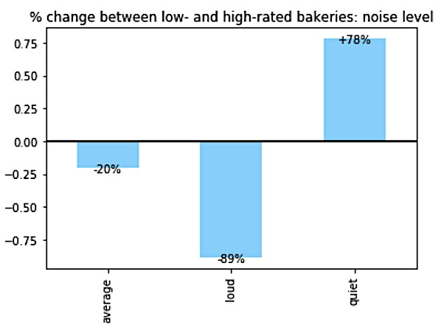
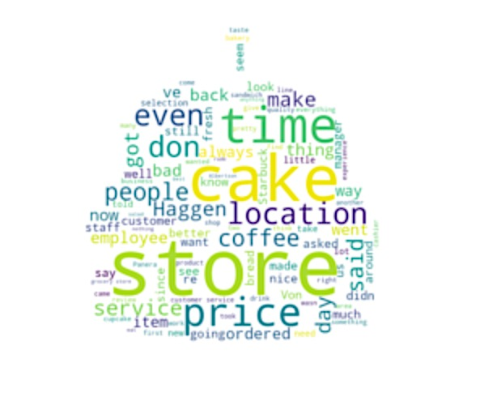
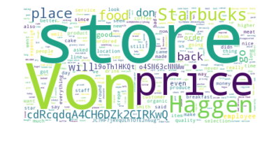
Attributes
HIGH RATING
Analysis directions
Top 10 Bakeries:
Cake
Red velvet (flavor)
Bundt cake (type)
Bread
Cupcake
Toronto
cake, macaron, coffee, ice cream
The city has the most high-score bakeries: Toronto
The city has the most low-score bakeries: Las Vegas
Rating (stars)
The total number of bakeries: Toronto/ Las Vegas
The ratio that high-low bakeries: Montreal/Edinburgh
LOW RATING
High rated—over 4 stars: What are the common characters and what we should focus on.
Low rated—below 2stars: The things to avoid.
All Bakeries with stars lower than 2:
Cake
Time
Location
Price
Location
price, Starbuck
Las Vagas

Slide 3
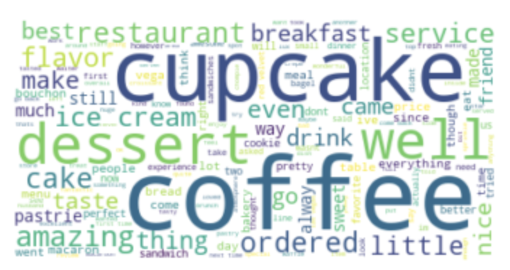
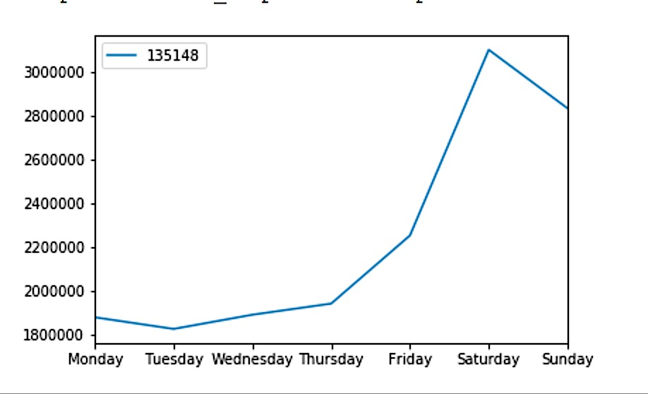
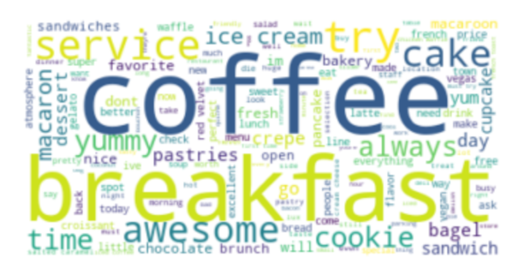
Popularity
Analysis directions
An overall Peak at weekends.
In top 30 popular bakeries, most are in State AZ and NV.
The most popular bakeries’ brands are WinCo Foods, Chompie's Del, Bouchon, Amélie's French.
NEXT STEP
END
Exploring outside the market and related it to the related coffee shop market, make comparisons and thinking of the transformation between shop types and follow the trend of ”bakery cafe”.
Thank you!
Popularity (check_in)
NV
WinCo Foods
The distribution of overall check-in.
The top 20 busiest bakeries: Brands, characters and common focus in reviews.
Jordan Fisher, Jeeva Ramamoorthy Qiao Zhang, Wanmo Chen, Xuan Yang
Chompie's
Del
AZ

